Slide 1
BELBIN Team Roles

Slide 2

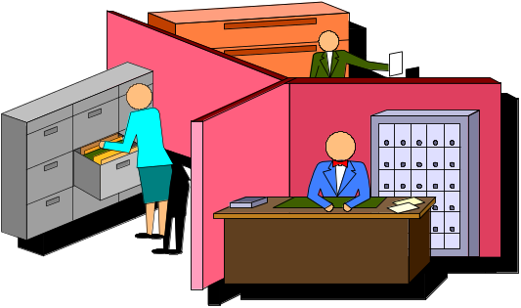
Team Roles and Functional Roles
Team Role
Is our contribution to the team based on personal ability and characteristics
Functional Role
Is the contribution to the team based on acquired knowledge and professional experience

Slide 3
3 x 3 Team Roles
Action Roles
2. Social Roles
3. Thinking Roles
Shaper
Implementer
Completer Finisher
Coordinator
Teamworker
Resource Investigator
Plant
Monitor Evaluator
Specialist

Slide 4
Key stages for succes
Implementer
Coordinator
Completer
Implementer
Ressource
Investigator
Teamworker
Monitor
Evaluator
Specialist
Plant
Resource
Investigator
Shaper
Coordinator
Identify
needs
Finding
ideas
Formulate
plans
Making
contacts
Establish
organization
Following
through

Slide 5




Teamorientation and Team Roles
Stable
IMP
CO
TW
ME
RI
D
A
Introvert
Extrovert
C
B
PL
SP
SH
CF
Anxious

Slide 6
Group dynamics
Stable
Good at planning and implementation
Need time to analyse and decide
May not consider the implications of change
Good social contact
Enjoy working in teams
Versatile in method
Effective use of resources
Lively, but unambitious
Coordinating
Cooperating
Exploring
Analysing
Organizing
Introvert
Extrovert
Innovative
Specialized
Follow-through
Driving
Lots of good ideas
Knowledgable
Dedicated
Internal competition
Lack of structure and process
Dynamic
Generate action
Challenging and competitive
Thick skinned and argumentative
Anxious

Slide 7
Group dynamics
Stable
Results satisfactory but not extraordinary
Good results when preassured, but high degree of interdependency
Coordinating
Cooperating
Exploring
Analysing
Organizing
Introvert
Extrovert
Creative
Specialized
Follow-through
Driving
Few, marginal results
Delivers results.
Good at changing conditions and handling obsticles
Anxious

Slide 8
Group Dynamics
Extroversion
Refers to type of personality, first identified by Jung, whose interests are directed outwards to the external world. Extroverts require more intense stimulation and get energy from social interaction.
Introversion
Discovered by Jung as applying to type of personality dominated by inner thoughts and feelings rather than the outside world and social contacts.
Stability
Stable individuals tend to be easy-going and acceptable ti a wide range of people.
Anxiety
Anxious individuals are easily aroused. With strong discipline and selfcontrol it tends to be converted into energy and drive. When discipline is low, anxiety is inclined either to exert an unsettling effect on others or high levels of inner stress.

Slide 9
What underlies Team Role behaviour?
Personality
Role Learning
Behaviour
Mental abilities
Experience
Current values and
motivation
Field constraints

Slide 10
Teamroles and leadership
Solo-leader
Team-leader
Plays unlimited role
  (interferes)
Strives for conformity
Collects acolytes
Directs subordinates
Projects objectives
Chooses to limit role
  (delegates)
Builds on diversity
Seeks talent
Developes colleagues
Creates mission

Slide 11

A cross functional team
”To every leader there is a season”
Winston Churchill
The ideal leader
CO
TW
RI

Slide 12

A project team
The ideal leader
" There is an attribute without which leadership cannot exist. Courage ....
This is not a job for compromisers, or those who lean towards popularity, for this is a key attribute of leadership, for the problem solver of today and tomorrow".
Michael Edwards
SH
IMP
CF
A project team aims for results effectively

Slide 13

A strategic team
"Leaders need objectivity, a certain detachment. They subordinate themselves to the task. The task remains bigger than they are, and different. The worst thing you can say about a leader is that on the day he or she left, the organization collapsed".
Peter Drucker
The ideal leader
ME
CO
PL
Strategic teams create
vison and show direction

Slide 14
Group or team – what is the difference?
  Workgroups
  Formally appointed leader
  Individual responsibilities
  Department mission is functional
  Individual reward systems
  Effective meetings
  Department effectiveness measured in importance to the company (f.ex. Turnover)
  Discuss, decide, delegate
  Teams
  Shared leadership
  Individual and mutual responsibility
  Team objectives, defined by the team itself
  Shared outcome
  Open discussions and problemsolving
  Team effectiveness measured by team results
  Discuss, decide and work together

Slide 15
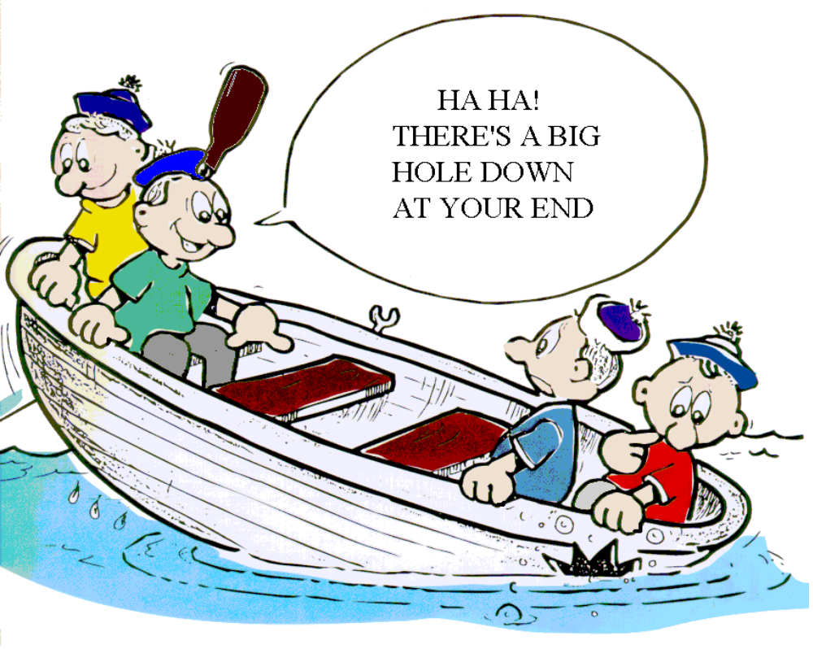
Team Spirit ?
HA HA!
THERE’S A BIG
HOLE DOWN
AT YOUR END

Slide 16
To be a team (1 af 2)
Basic framework
Shared values
The team values and norms correspond with the team members understanding of right and wrong
Shared vision and objectives
Everybody understands and accepts the objectives
Accept of plan
A plan, which is accepted by everybody and gives a clear picture of what has to be done

Slide 17
To be a team (2 af 2)
Basic framework
Task allocation
Allocation of tasks and resources. Everybody understands how they can contribute to the process
Open communication
Communication, both formal and informal, is encouraged
Coperation
People interrelate, improvise and support eachother – the individual feels responsible for the process as such, not only his own task

Slide 18
Qualifications of winning teams
1. Person in charge (teamleader)
commanding
gererates trust
uses others abilities
does not dominate
pulls threads together
2. One strong Plant
▪ used effectively
3. Spread of mental abilities
Plant + Monitor Evaluator +
Coordinator + Specialist
4. Spread of personal attributes
cover of support roles
spread of introverts and extroverts
minimises unconstructive friction
5. Match between attributes of members
and responsibilities in the team
team roles to fit personal characteristics
based on natural role-behaviour,
not allocated based on area of expertise only
6. Adjustment to realisation of imbalance
self insight
consider team strenghts and weaknesses

Slide 19
Nobody is perfect – but a team can be!
Reasons for identifying peoples team role contributions:
To compose a balanced team
To build on teammembers existing strenghts
To understand weaknesses and therefore compensate for them
To identify career opportunities
To identify possible conflicts with people of similar preference and roles
To enhance trust, openess and maximise co-operative working
To realise team role gaps or overlaps present within a team

Slide 20
Less effective teams
1. Moral
▪ Marginal
2. Mental capacity
▪ Over critical and oppositional, at
least one person
3. Members with no team role
Tend to move about
Some do not fit
4. Unknown elements
Tend to concentrate on job, no role
Indifferent team performers
Suspicious about need for teamwork
5. Unbalance
Extroverted: social, outward looking,
thrive on new situations,
casual on follow through
Introverted: self sustaining, withdraw
    into themselves, pursue
    internally generated goals.
    Too much anxiety
6. Team role reversal
mismatches lead to competition, misfit and
discomfort, or stress
7. Corporate thinking
▪ functional focus

Slide 21
How to manage your teamrole profile
Preferred roles
Manageable roles
Roles to be avoided
Promote your natural
Team Roles
Make sure your
language and your
behaviour is in line
Make Team Role
sacrifice
Let those who
have a
clear preference
play the role
Find your weakest
role as a strength
in others
Delegate
Build
complementary
teams

Slide 22
TEAM ROLE OPPOSITES
MONITOR
EVALUATOR -
judges impartially
PLANT -
theorises
CO-ORDINATOR -
generalises
COMPLETER
FINISHER -
perfects established
systems
SHAPER -
drives
RESOURCE
INVESTIGATOR
recognises
opportunities
TEAMWORKER -
supports
SPECIALIST - specifies
IMPLEMENTER - applies

